Slide 1
MCB3421 2017
Class 1 & 2

Slide 2
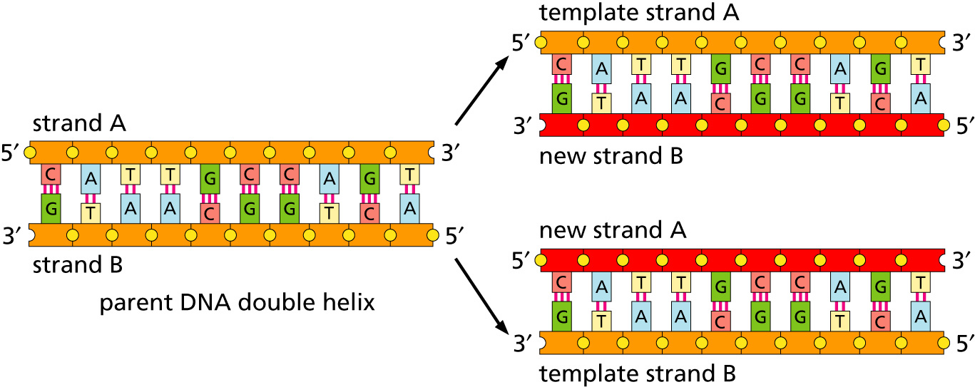
Replication
lagging and leading strand - strand bias
see Drew Barry’s animation at https://www.youtube.com/watch?v=7Hk9jct2ozY at 2.30 minutes

Slide 3
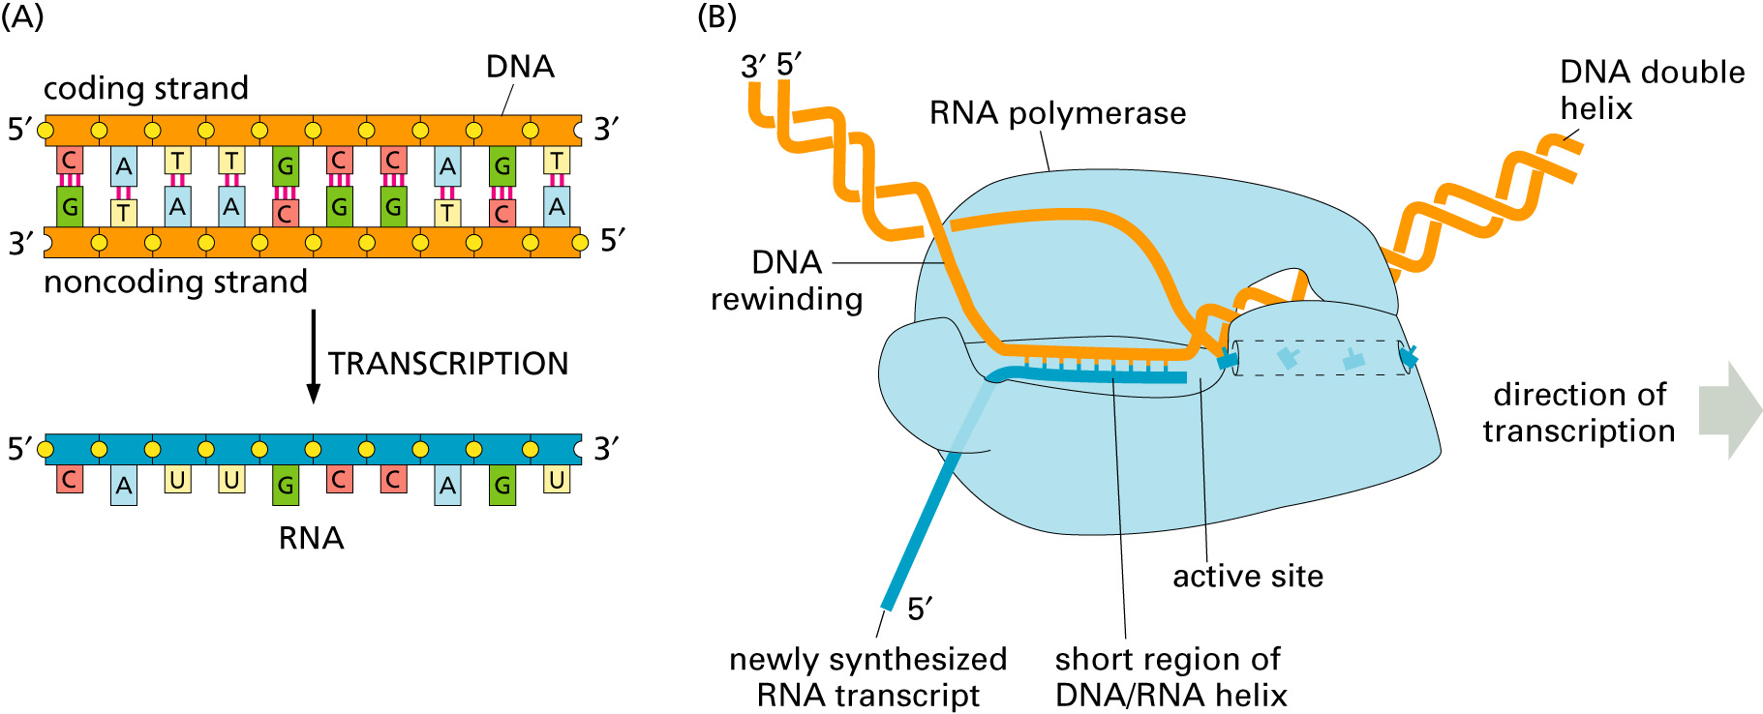
Transcription

Slide 4
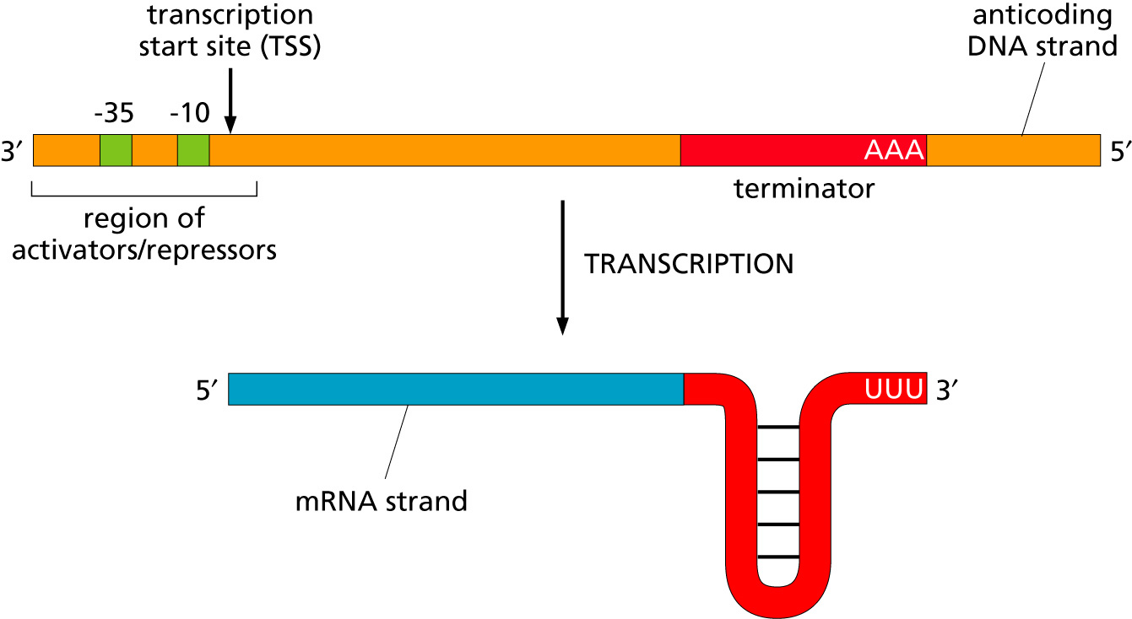
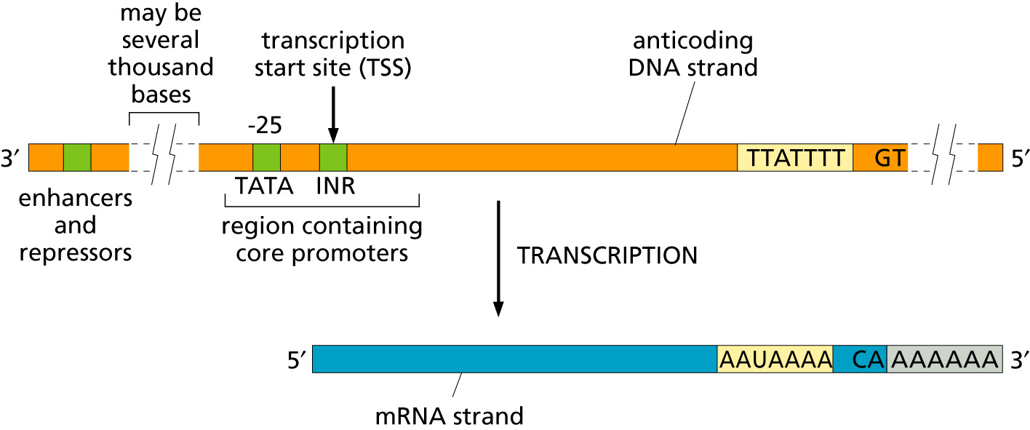
Transcription
Bacteria
Eukaryotes

Slide 5
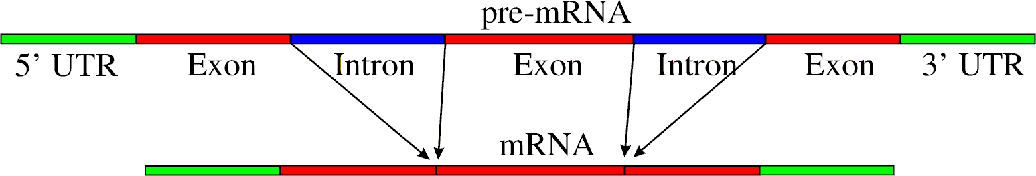
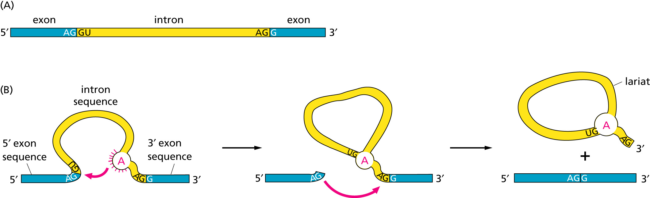
RNA processing
Simple illustration of a pre-mRNA, with introns (top). After the introns have been removed via splicing, the mature mRNA sequence is ready for translation (bottom).
Intron types
RNA can be the catalyst

Slide 6
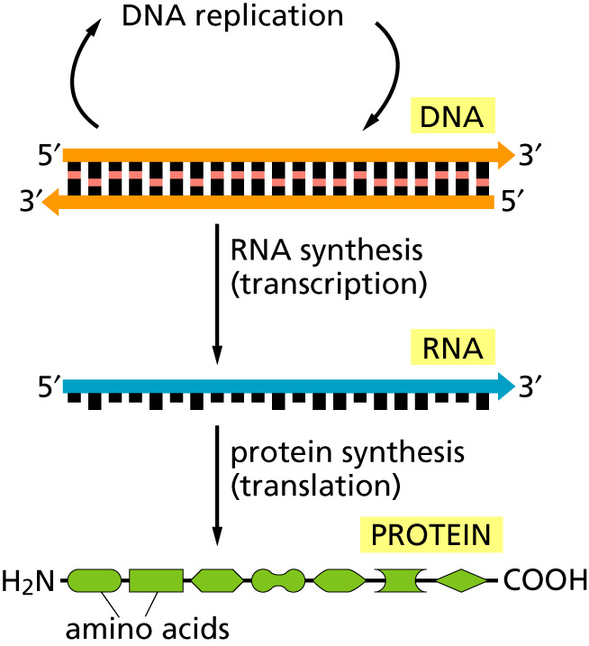
The central dogma
Why might this be wrong or incomplete

Slide 7
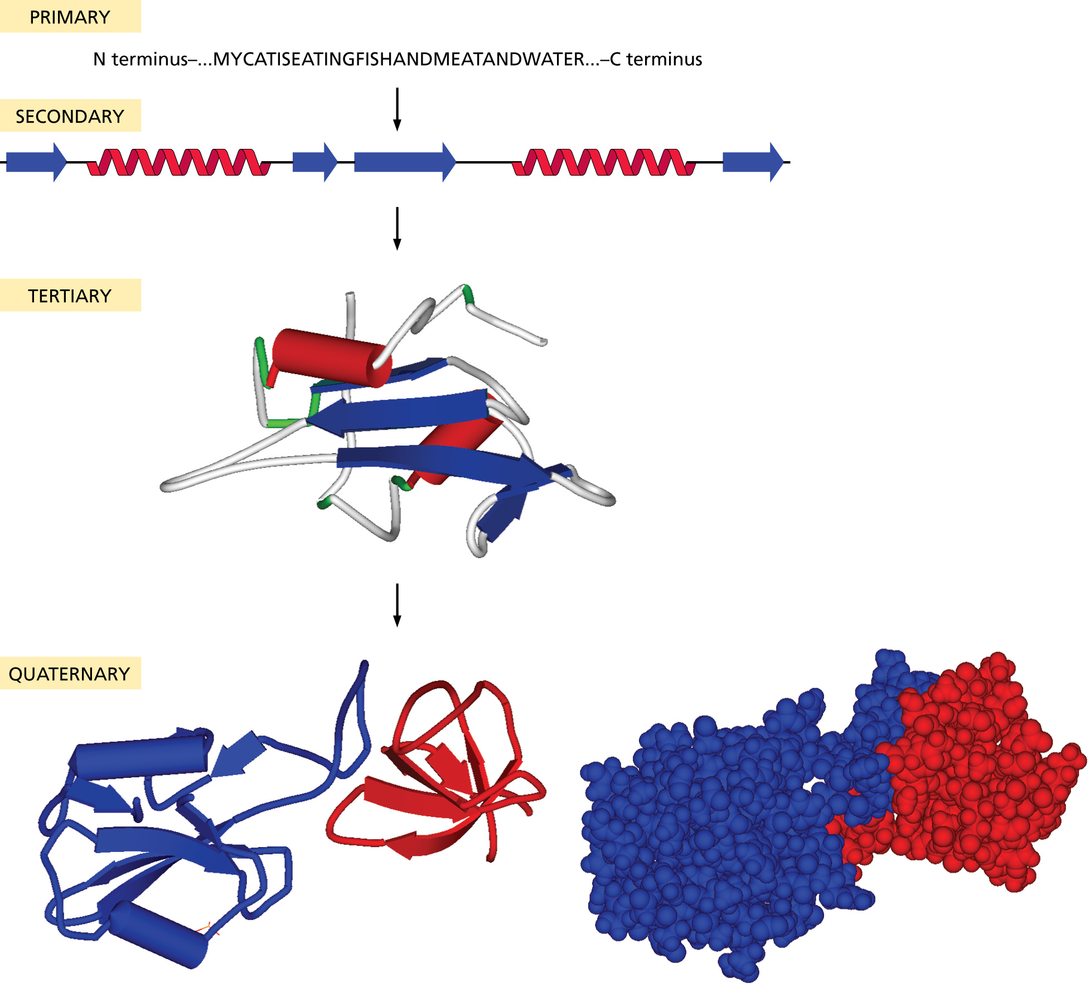
Protein structure:

Slide 8
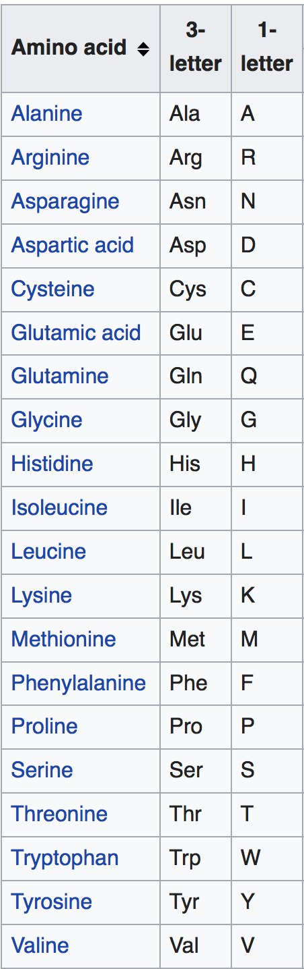
Primary structure
20 typical amino acids from the
primary sequence of a protein:
The sequence is written from the
amino to the carboxy terminal

Slide 9
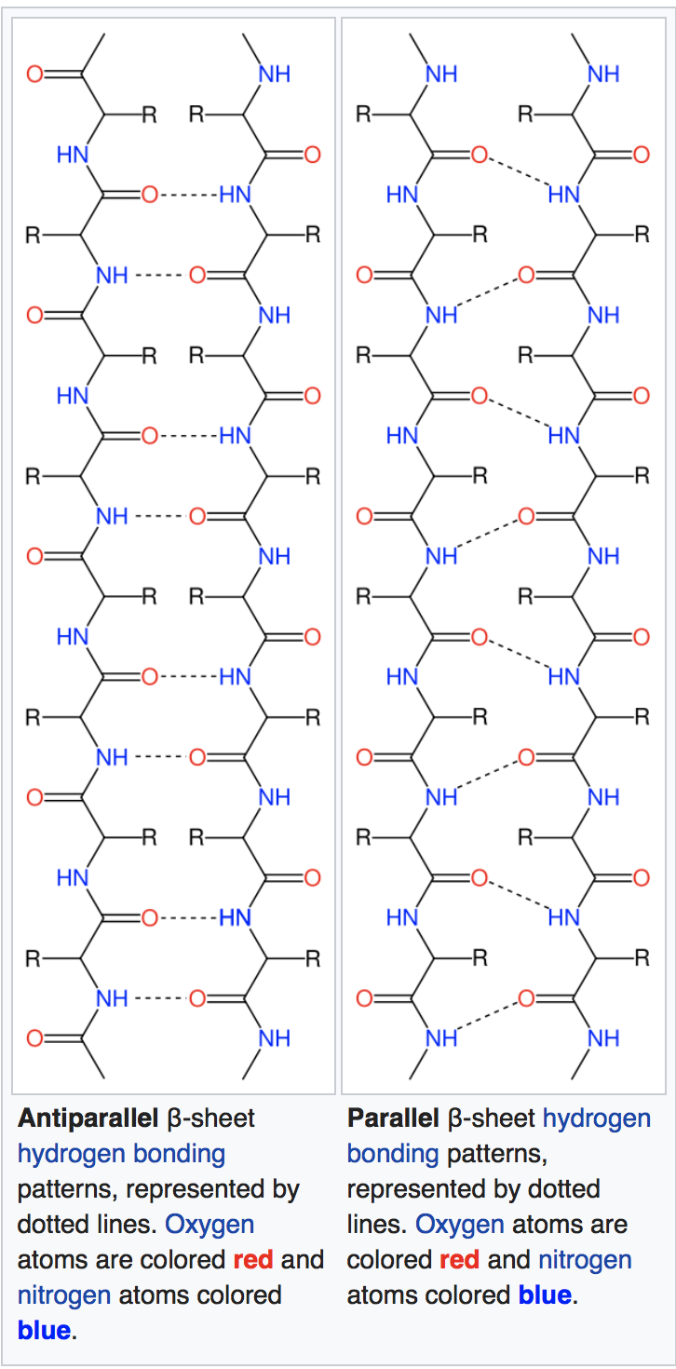
Important secondary structure elements (local folds)
Beta sheets
Often depicted
as yellow arrows
From Wikipedia
https://en.wikipedia.org/wiki/Beta_sheet
https://en.wikipedia.org/wiki/Beta_barrel

Slide 10
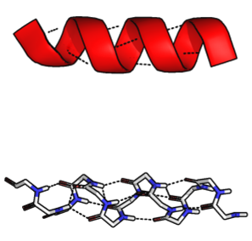
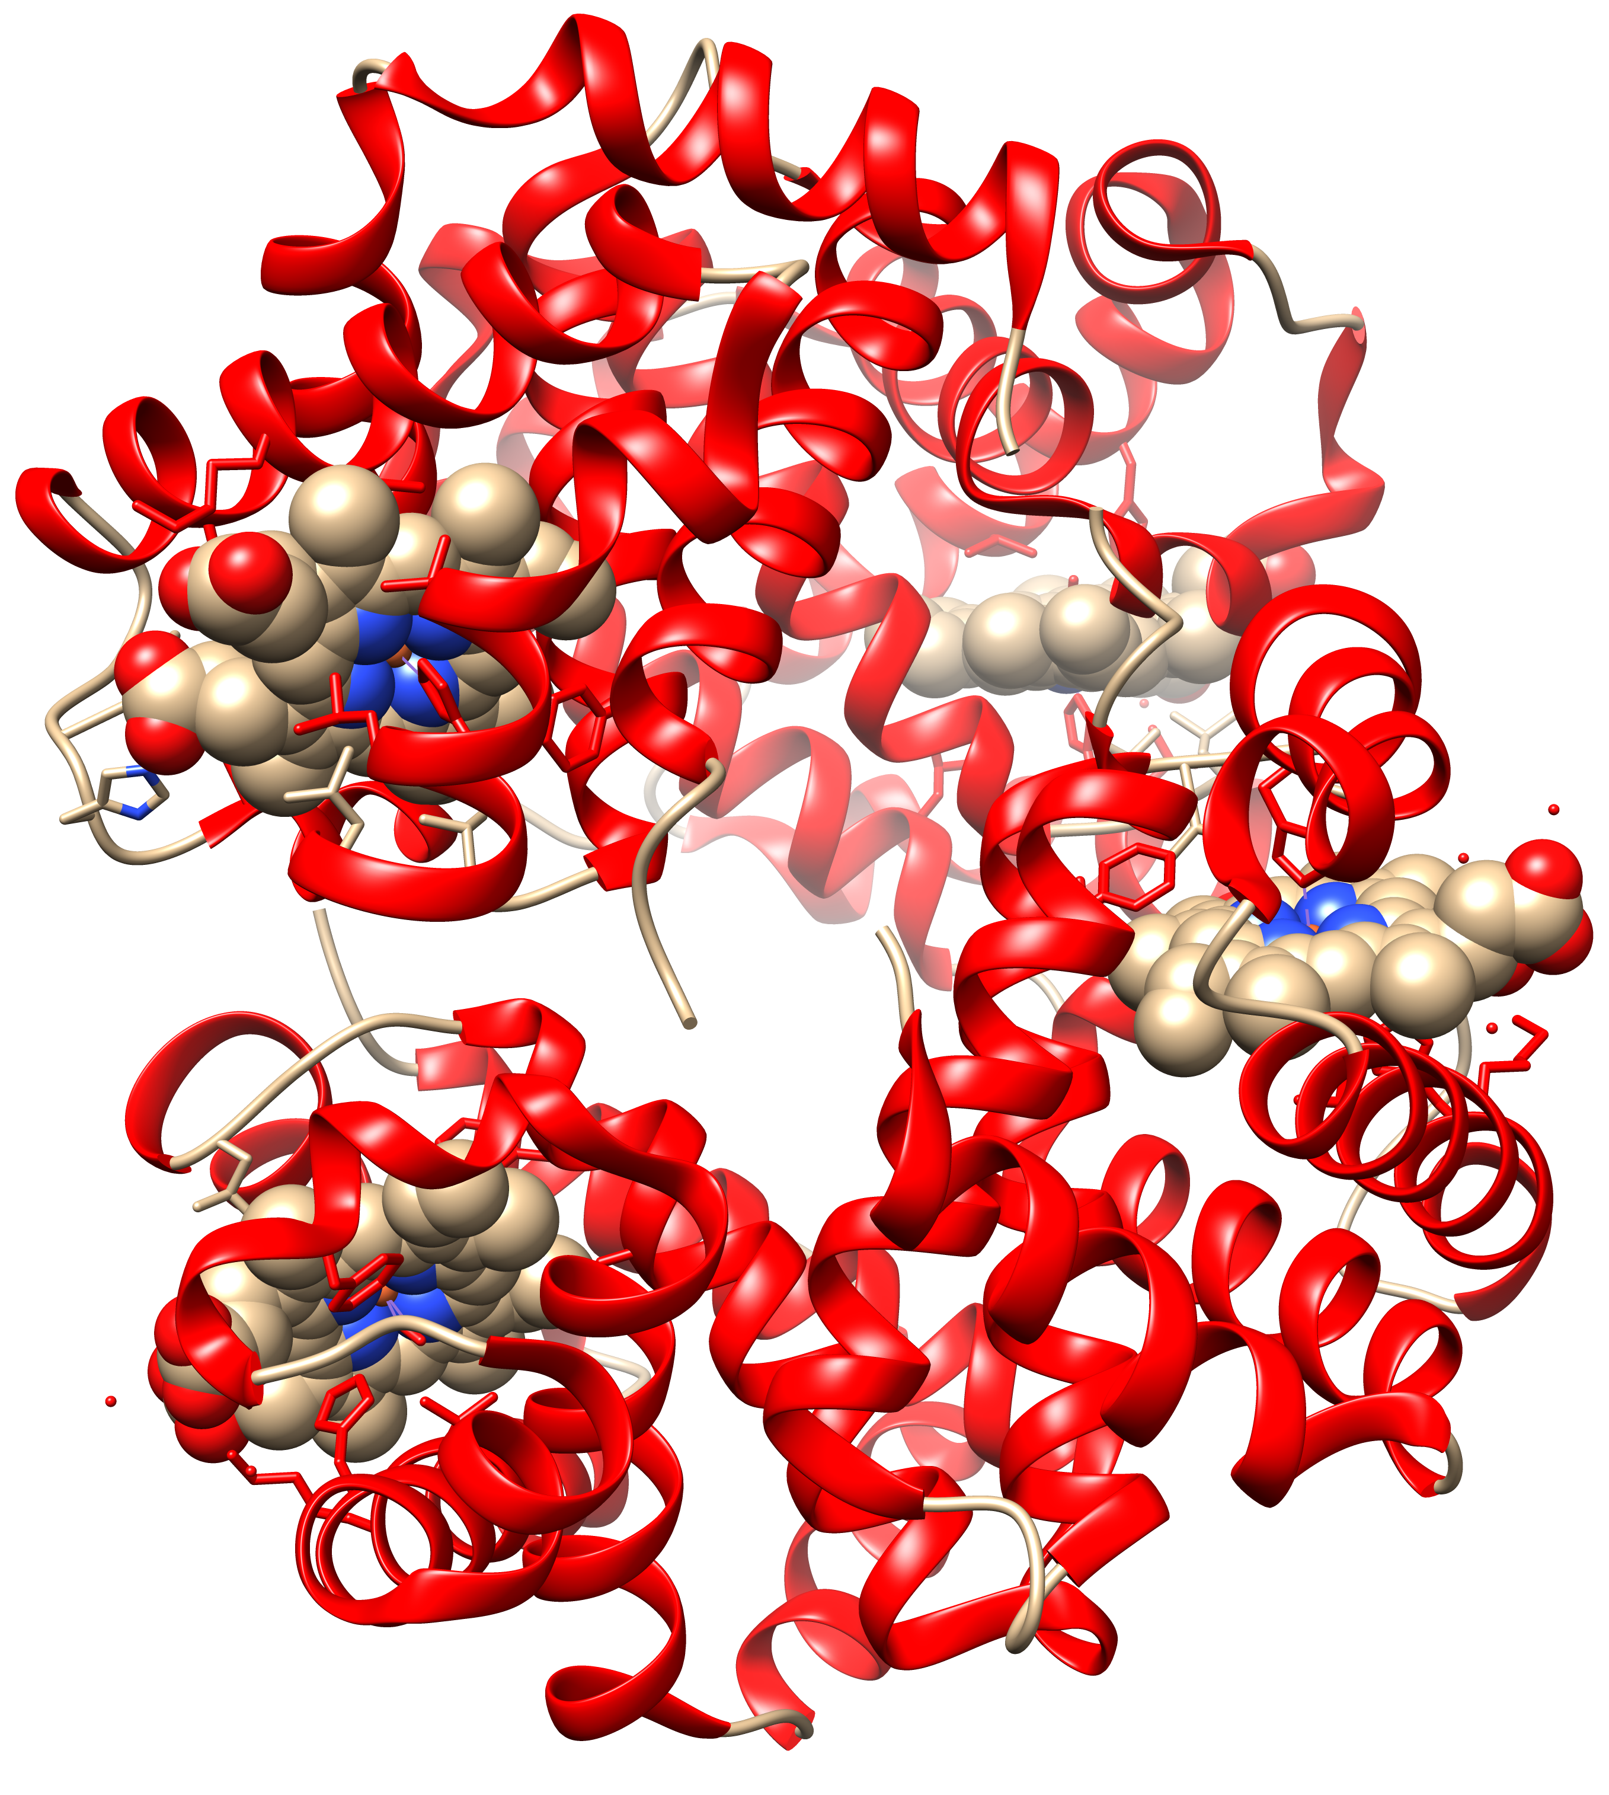
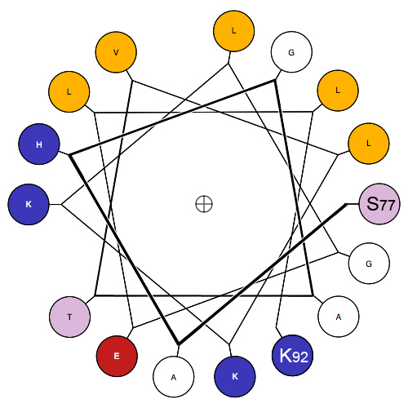
Important secondary structure elements (local folds)
Alpha Helices
Often depicted as red spirals
1GZX.pdb
Modified from Wikipedia
https://en.wikipedia.org/wiki/Alpha_helix
https://en.wikipedia.org/wiki/Hemoglobin

Slide 11
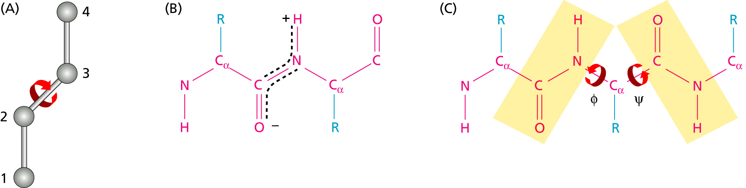
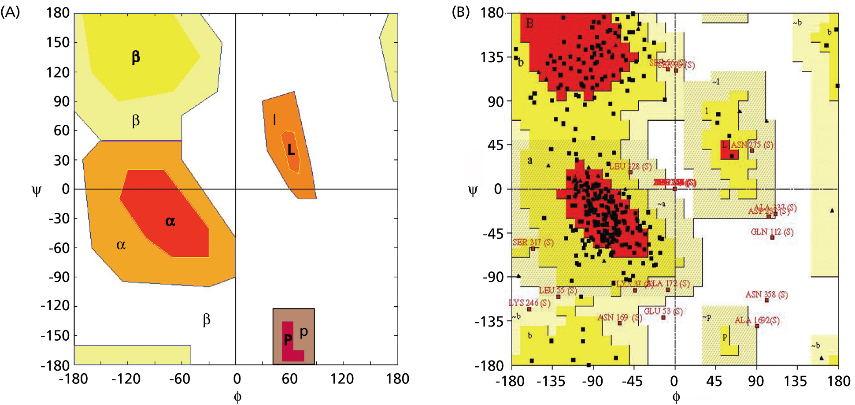
Angles in the protein backbone

Slide 12
UCSF’s Chimera
Free and powerful program to work with protein structures
Steep learning curve
(command line and/or menu driven)
Available for free at http://www.rbvi.ucsf.edu/chimera/
Many tutorials are available on the program’s webpage and on youtube.

Slide 13
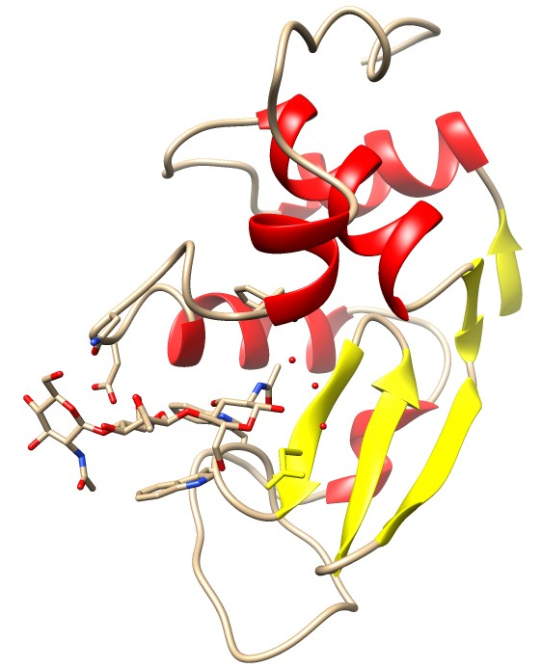
Lysozyme
Cleaves the sugar backbone on the cell wall of bacteria (which leads to exploding bacteria).
Present in tears, salvia, egg white, …
The N-acetylglucosamine (NAG) trimer is an inhibitor that binds to the catalytic site

